Slide 1
产品
哪种类型产品的存货量最高？
哪种类型产品的目前订购量最高？
哪些种类产品的订单量在增长？
哪个产品的销售量最高？

Slide 2
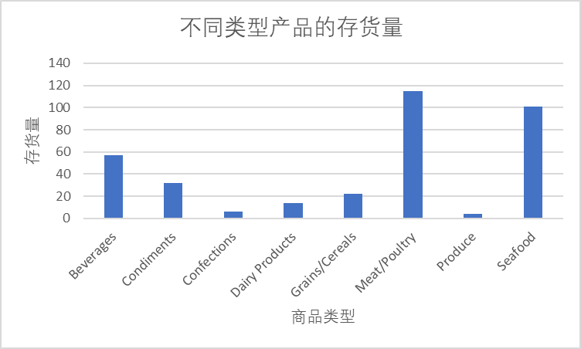
<哪种类型产品的存货量最高>
<visualization>
从左图，可知Meat/Poultry的存货量，超过了100.达到了115，所以Meat/Poultry的存货量最高
Notes:
select CategoryName,CategoryID, UnitsInStock
from(select *
from Categories c
JOIN Products p
ON c.CategoryID = p.CategoryID)substr
group by CategoryID
order by 2

Slide 3
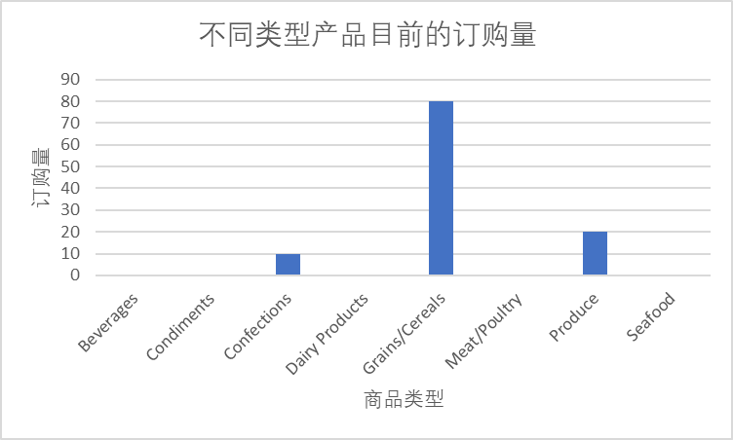
<哪种类型产品的目前订购量最高？>
<visualization>
由左图可知，Grains/Cereals产品的订购量最大，达到了80.
说明目前Grains/Cereals类型产品的订购量最高
Notes:
select CategoryName,CategoryID, UnitsOnOrder
from(select *
from Categories c
JOIN Products p
ON c.CategoryID = p.CategoryID)substr
group by CategoryID
order by 2

Slide 4
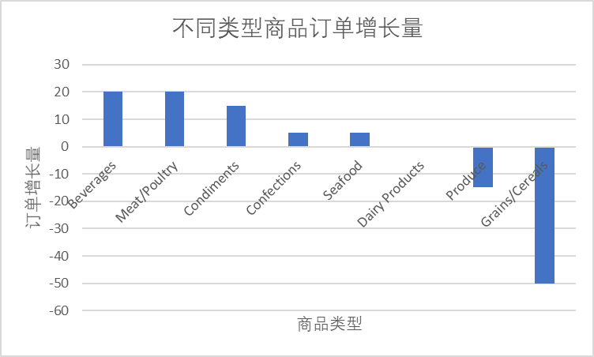
<哪些种类产品的订单量在增长>
<visualization>
由左图可知，有五种类型产品的订单出现了增长，分别是Beverages；Meat/poultry；Condiments；Confections；Seafood。一种类产品的订单量保持不变，它是Dairy Products。两种类型产品的订单出现负增长，分别是Produce和Grains/Cereals。
Notes:
select CategoryName,CategoryID,ReorderLevel - UnitsOnOrder as increase_order
from(select *
from Categories c
JOIN Products p
ON c.CategoryID = p.CategoryID)substr
group by CategoryID
order by increase_order desc

Slide 5
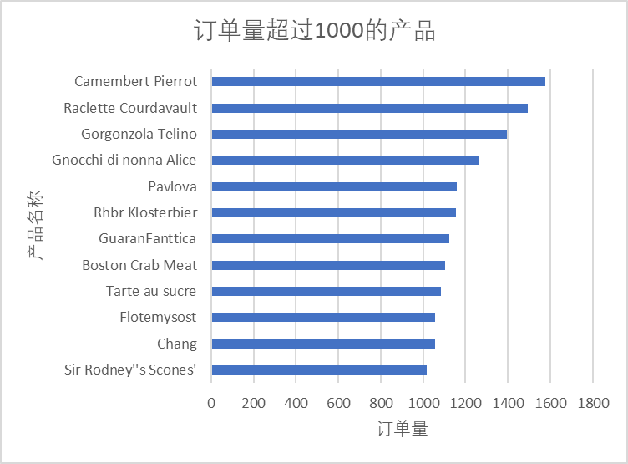
<哪个产品的销售量最高？>
<visualization>
由左图统计可以看出，产品名为Camembert Pierrot 被订购的数量超过了1400，总订购数量为1577，说明Camembert Pierrot 的被需求量最大
Notes:
SELECT ProductID,ProductName,SUM(Quantity)
from
(select *
from OrderDetails d
join Products P
on d.ProductID = p.ProductID
) Q
join Orders o
on Q.OrderID =O.OrderId
Group by ProductName
having SUM(Quantity) > 1000
ORDER BY 3

Slide 6
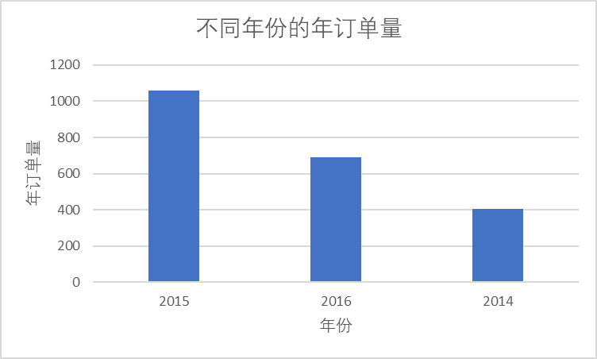
<哪一年的订单量最大？>
<visualization>
由左图可知，2015年的销量最高超过了1000份订单，所以2015年的销量最大。
Notes:
select strftime('%Y', orderdate) ord_year, COUNT(*) total_Quantity,OrderId
from(select *from Orders o
JOIN OrderDetails od
ON o.OrderId = od.OrderID)substr
group by 1ORDER BY 2 DESC;

